Slide 1


CAPSTONE – PROJECT
(UNIVERSITY SUCCESS ANALYSIS)
Here are brief analysis insights for each of the Power BI questions and EDA questions provided:
by Vineet Tewari

Slide 2

.

Slide 3

.

Slide 4
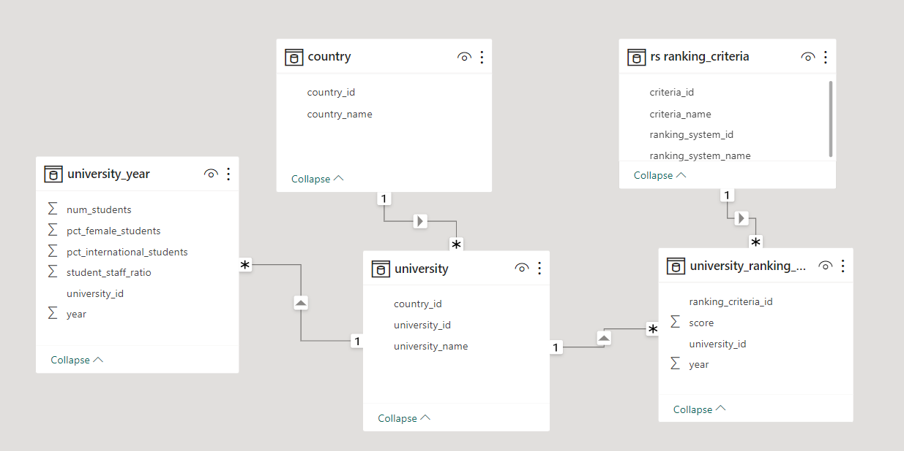
ER-DIAGRAM
.

Slide 5
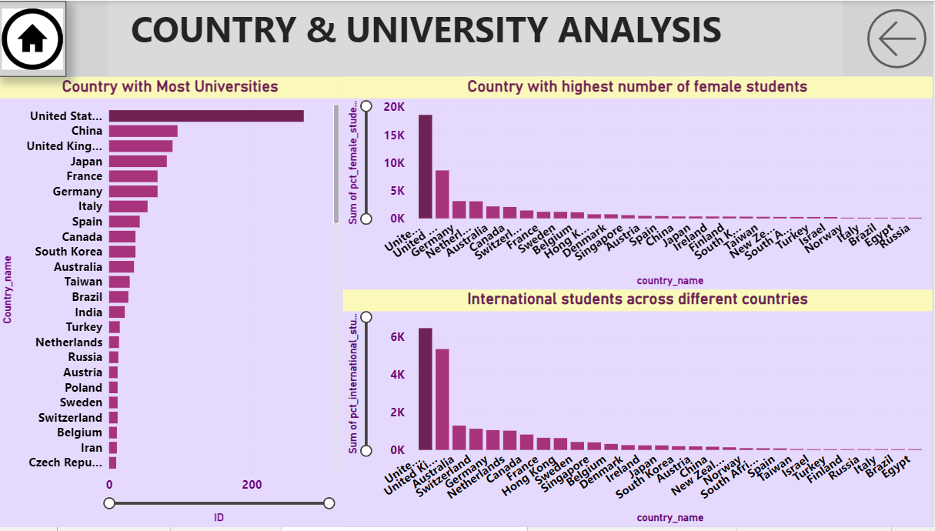
.

Slide 6
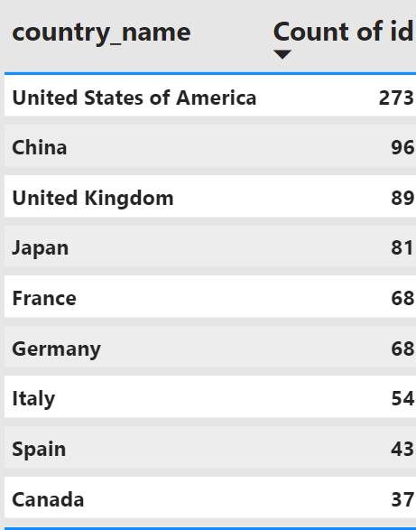
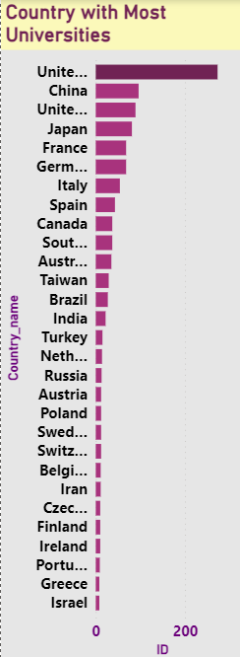
How many universities are there in each country?
The number of universities in each country.
Understanding the distribution of universities by country USA is at the top with 273 universities.

Slide 7
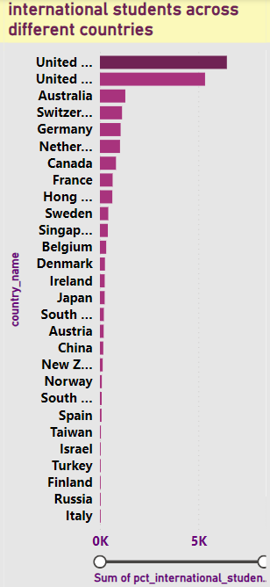
What is the distribution of international students across
different countries?
GA bar chart displaying the distribution of international students across different countries in this USA and UK at the top.
Guides recruitment strategies and fosters campus diversity.

Slide 8
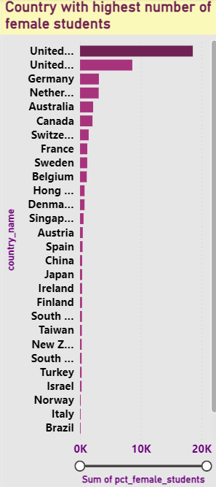
Which country has the highest number of female students
enrolled in universities?
GThe country with the highest number of female students in USA

Slide 9
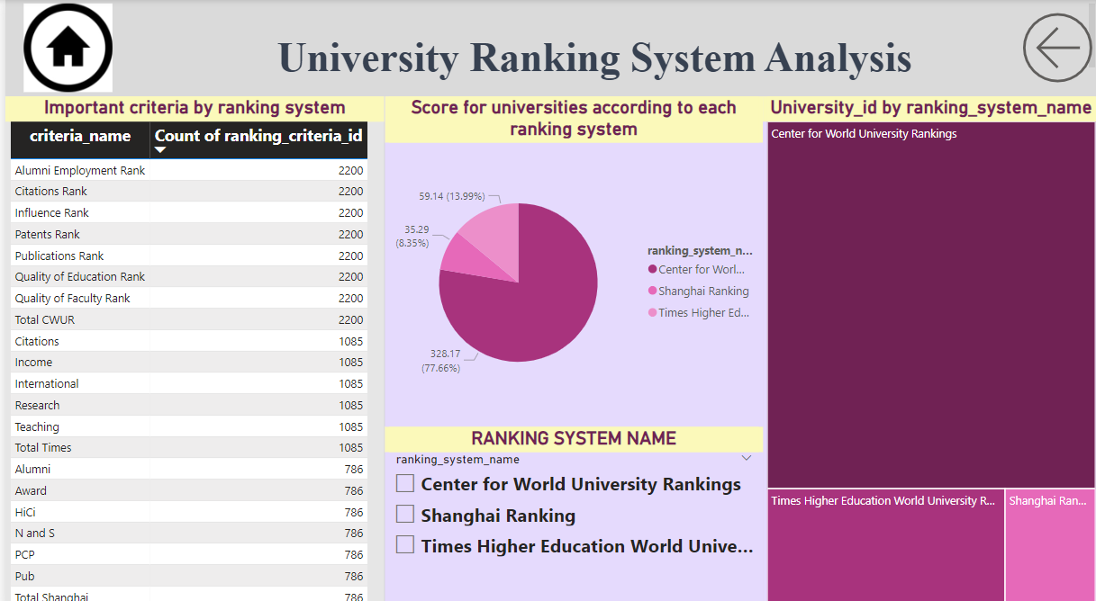
.

Slide 10

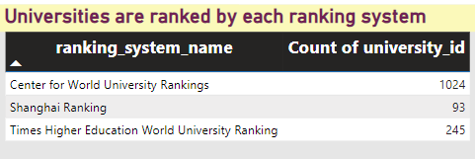
How many universities are ranked by each ranking system?
A tree map displaying the number of universities ranked by each ranking system.
Center for world university rankings is at the top.

Slide 11
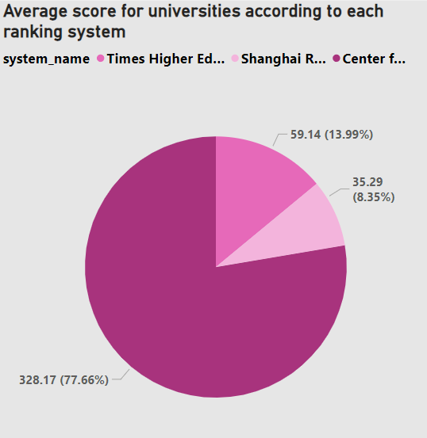
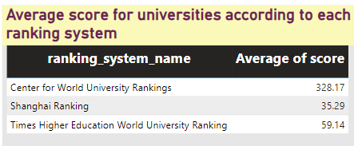
What is the average score for universities according to
each ranking system?
A table and pie-chart displaying the average scores for universities according to each ranking system.
The center for world university rankings is at top.

Slide 12
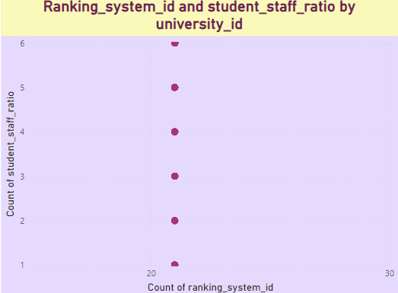
How does the ranking system affect a university’s
student-staff ratio?
Scatter plots showing the relationship between ranking scores and student-staff ratios for different ranking systems.
Can guide universities in resource allocation and staffing decisions.

Slide 13
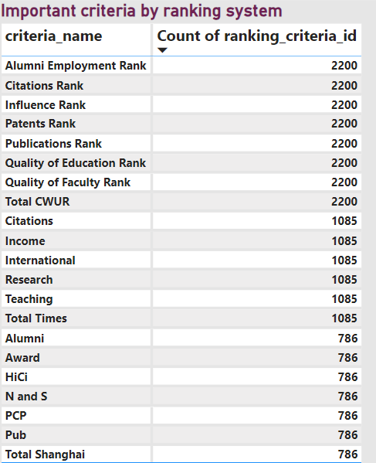
What are the most important criteria considered by
ranking systems?
A table listing the key criteria considered by each ranking system.
The top 3 criteria are: Alumni employment rank , citations rank, influence rank

Slide 14
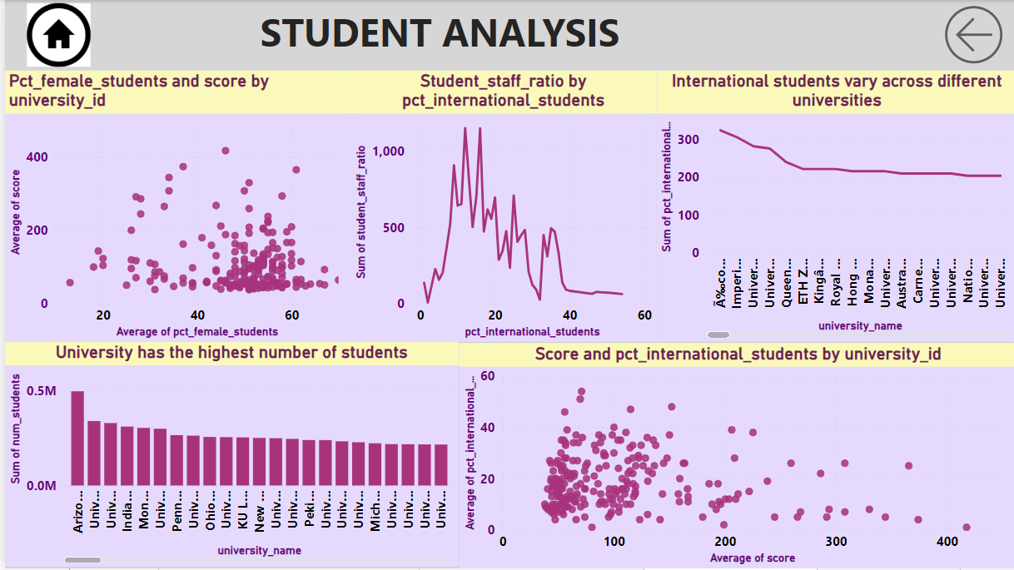
.

Slide 15
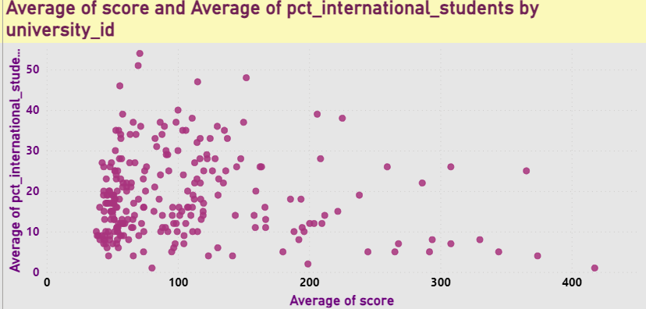
Is there a correlation between a university's score and
the number of international students?
.
Scatter plots showing the correlation between ranking scores and the percentage of international students.
Informs universities about the potential influence of international enrollment

Slide 16
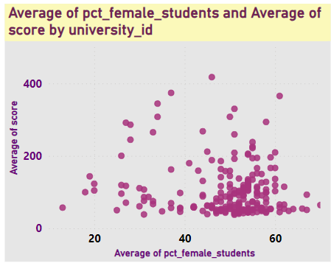
How does the percentage of female students impact a
university's ranking?
.
Scatter plots showing the impact of the percentage of female students on university rankings. This help in gender-inclusive education planning and policies.

Slide 17
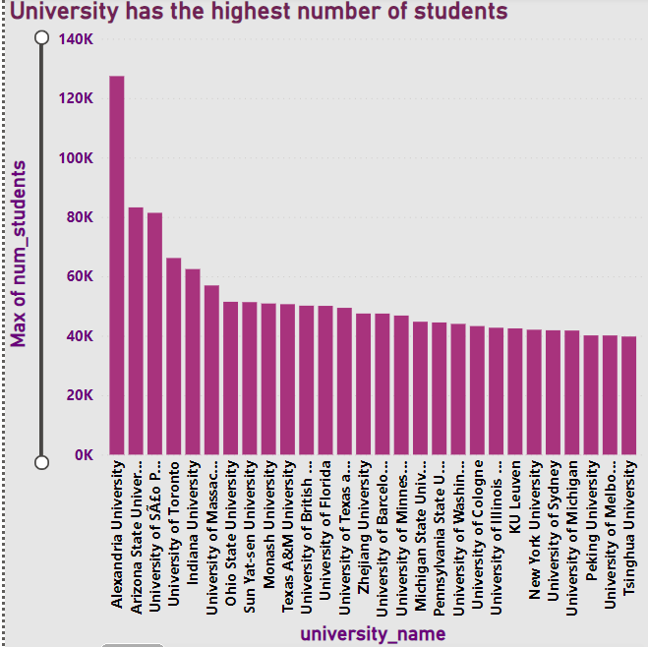
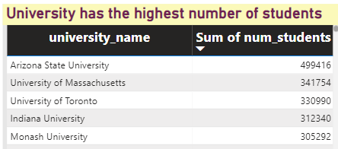
Which university has the highest number of students?
The university with the highest number of students:
Alexandria University

Slide 18
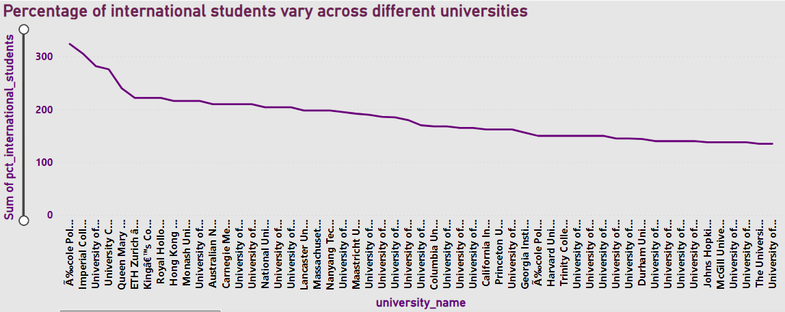
How does the percentage of international students vary
across different universities?
A Line chart displaying the variation in the percentage of international students across universities.
Highlights global appeal and diversity.

Slide 19
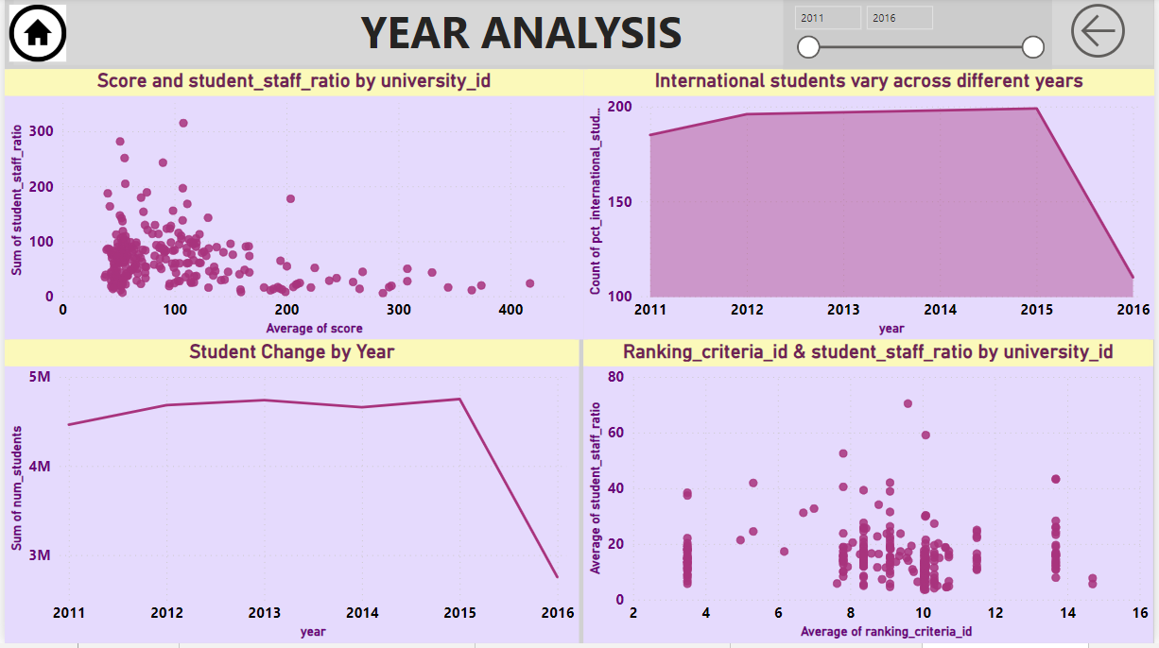
.

Slide 20
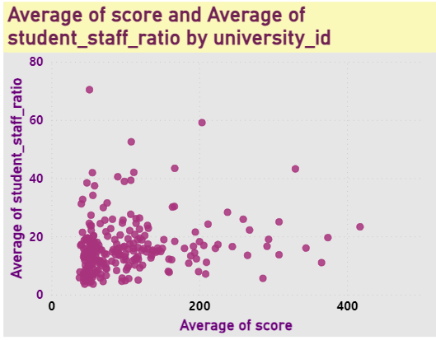
Is there a correlation between a university's ranking and
its student-staff ratio?
.
Scatter plots showing the correlation between university rankings and student-staff ratios.
Optimizes resources for academic support.

Slide 21
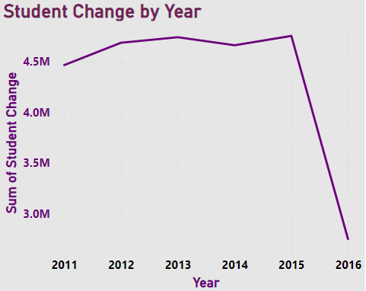
How does the number of students in universities change
over time?
Line charts displaying changes in the number of students in universities over time. As we see in the graph its starts declining from the peak of 4.7M in 2015.

Slide 22
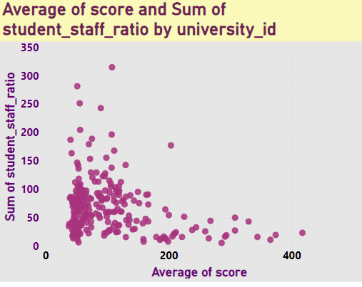
Is there a correlation between a university's ranking score
and the student-staff ratio over the years?
.
Scatter plot showing the correlation between university ranking scores and student-staff ratios over the years.
Links ranking efforts to academic quality.

Slide 23
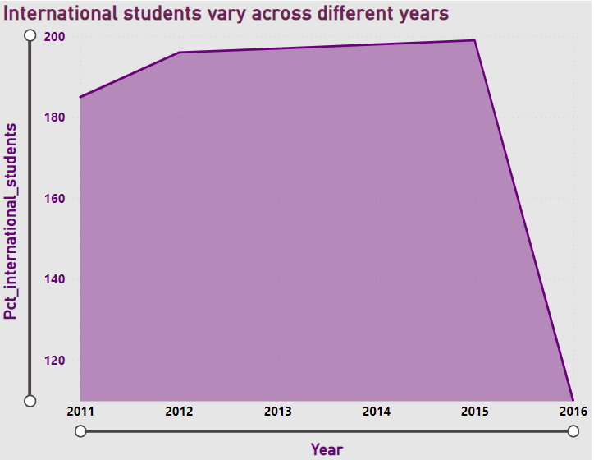
How does the percentage of international students vary
across different years?
…. Area chart showing variations in the percentage of international students across different year.
This shows changing trends in international student recruitment.

Slide 24
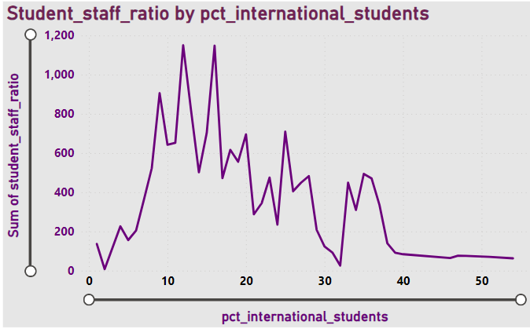
How does the percentage of international students affect
a university's student-staff ratio?
Line chart showing the impact of the percentage of international students on student-staff ratios.
Manages staff resources for diverse students.

Slide 25
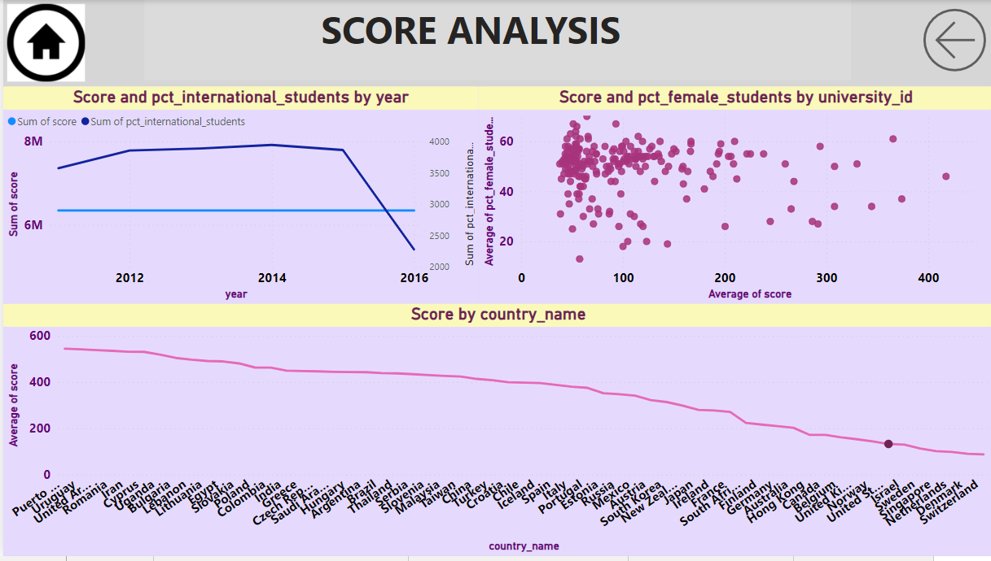
.

Slide 26
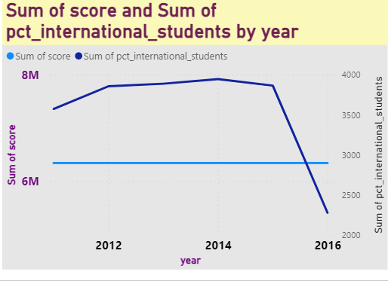
What is the impact of a university's ranking on the number
of international students it attracts?
.
Line charts displaying the impact of university rankings on the number of international students.
It helps universities strategically leverage rankings for international student.

Slide 27
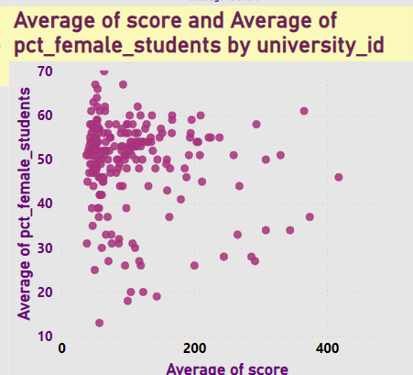
Is there a relationship between a university's ranking score
and the percentage of female students enrolled?
.
Scatter plots showing the relationship between university ranking scores and the percentage of female students.
It informs universities about the intersection of gender balance and academic reputation.

Slide 28
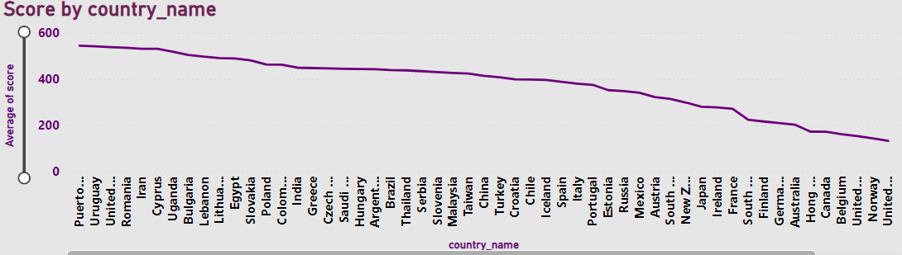
Are there any significant trends or patterns in the rankings
of universities from different countries?
Visualizations highlighting trends or patterns in university rankings across different countries.
Trends aids in benchmarking and strategic collaborations among universities and countries.

Slide 29
EDA SOLUTION START …
.
These questions were solved with the help of MySQL and then the outputs were exported to MS Excel , EDA and Visualizations were performed by Pivot table analysis and Charts.
z

Slide 30
Is there a correlation between a country's GDP and the
number of universities?
I don't have a specific column for GDP in this dataset, i will need to find an alternative source for GDP data or estimate it based on available information.
I can look for external sources of GDP data for countries. There are various sources such as the World Bank, International Monetary Fund (IMF), or national statistical agencies that provide GDP data by country.
.

Slide 31
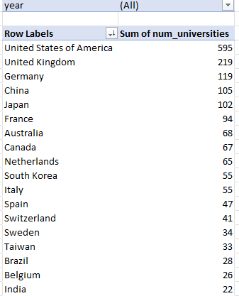
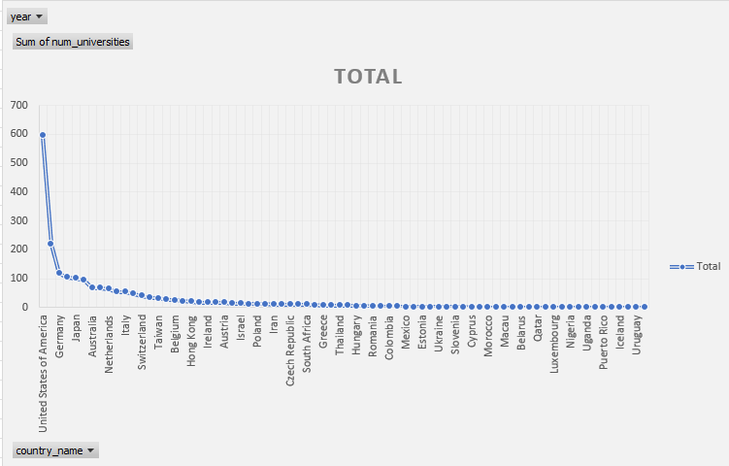
How has the number of universities changed over the
years in each country?
A table showing the change in the number of universities over the years for each country. In this we apply filter for year.
.

Slide 32
Is there a relationship between a country's population
and the number of universities?
I don't have a specific column for population in this dataset, i will need to find an alternative source for population data or estimate it based on available information.
Accurate population figures typically require data from official sources like national statistical agencies or international organizations, which are not typically found within Excel datasets.
.

Slide 33
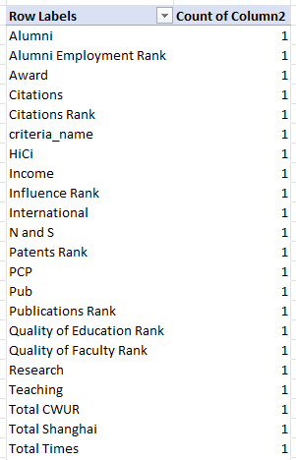
Are there any common criteria used by different ranking
systems?
As shown in the table there is no common criteria used by different ranking system
.

Slide 34
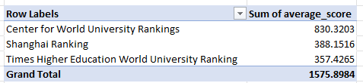
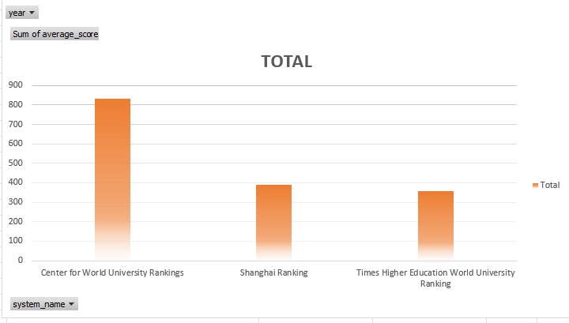
What is the trend in university rankings over the years
according to each system?
.
Trend lines or charts showing the ranking trends over the years for each system. Center for world university rankings is at top by 830.32

Slide 35

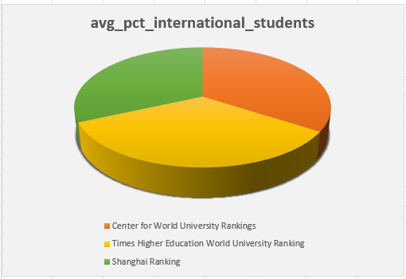
How does the choice of ranking system affect a university’s
international student enrollment?
A comparison of international student enrollment based on ranking systems. All three system are close to each other.

Slide 36
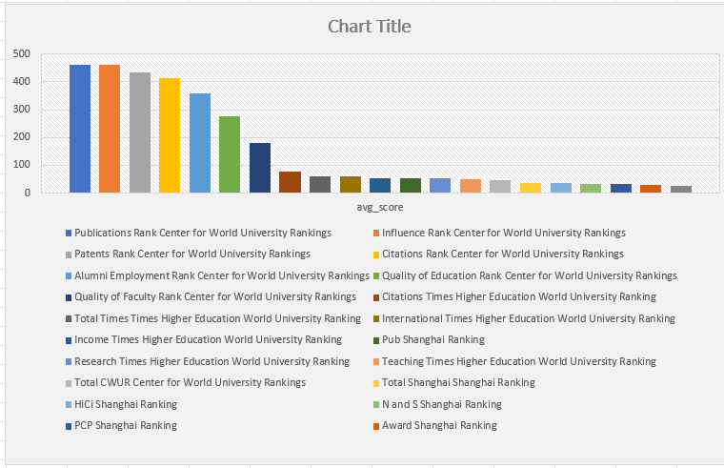
Are there any criteria that have different weights in
different ranking systems?
Yes, there are criteria that have different weights in different ranking systems. For example, the "Teaching" criterion may have a higher weight in one ranking system compared to another where "Research" is prioritized more.
.

Slide 37
How have the weights of ranking criteria changed over
time?
The weights of ranking criteria have changed over time, as shown in the image you provided. I filter the criteria name firstly and in X axis take year and in Y axis score.
.
Row Labels | Sum of avg_score
2005 | 251.2394
2006 | 250.4508
2007 | 247.8493
2008 | 249.8889
2009 | 248.7043
2010 | 245.7361
2011 | 596.5712
2012 | 1068.7621
2013 | 1088.4123
2014 | 3375.4903
2015 | 3485.8403
2016 | 391.6553
Grand Total | 11500.6003

Slide 38
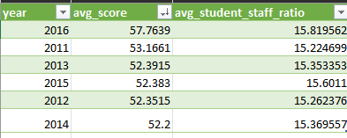
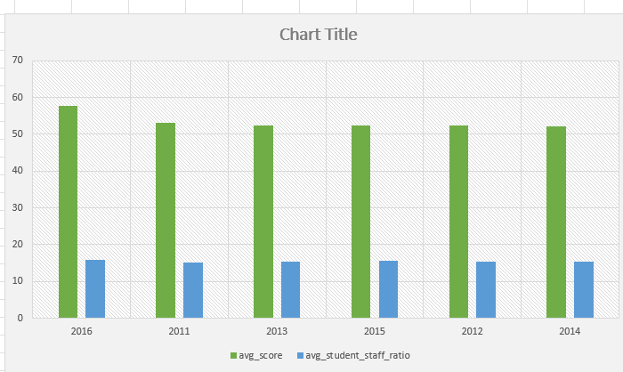
Is there a relationship between a university's score and
the student-staff ratio?
.
Correlation coefficient values for each university = 0.765410772

Slide 39
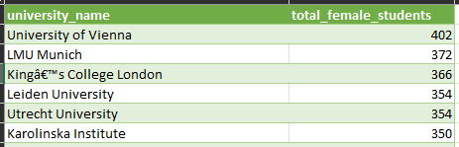
How does the number of female students differ among
universities?
.
The number of female students differs among universities in a number of ways. Based on the chart the top universities with the highest number of female students are:

Slide 40
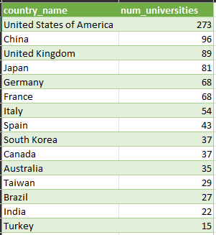
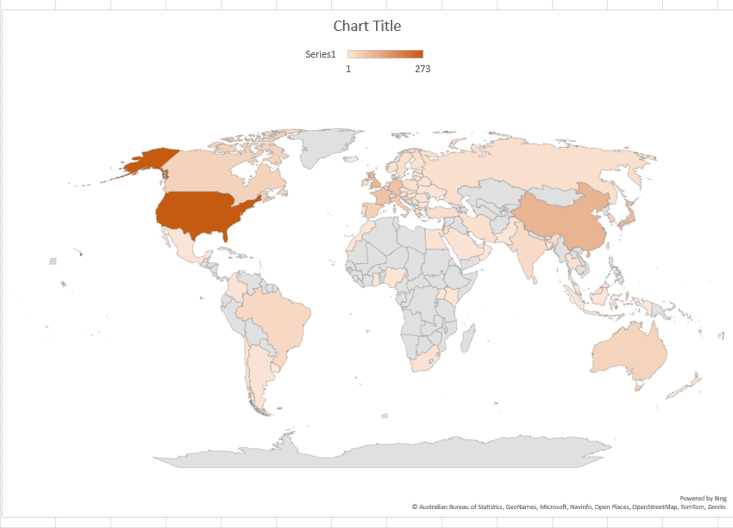
What is the distribution of universities across different
countries?
.

Slide 41
What is the trend in the percentage of female students
over time?
. According to the image provided, the percentage of female students enrolled in higher education worldwide has increased.

Slide 42
How has the ranking score of universities evolved over
the years?
The evolution of ranking scores over the years for each university.
.

Slide 43
.
THANK YOU

